Slide 1
Chapter 7
Conformity

Slide 2
Social Influence as “Automatic”
Social influence: The ways that people are affected by the real and imagined pressures of others.
  Conformity
  Compliance
  Obedience
  Resistance?
What factors lead human beings to yield to or resist social influence?

Slide 3
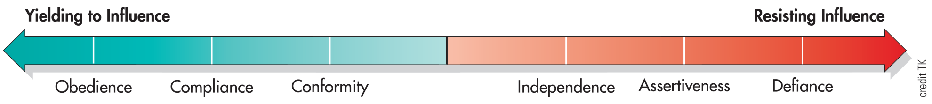
Continuum of Social Influence
Notes:
Figure 7.1 Continuum of Social Influence Social influences vary in the degree of pressure they bring to bear on an individual. People may (1) conform to group norms or maintain their independence, (2) comply with requests or be assertive, and (3) obey or defy the commands of authority.

Slide 4
Social Influence as “Automatic”
As social animals, humans are vulnerable to subtle, almost reflex-like influences
  Animals exhibit rudimentary forms of automatic imitation
  Humans unwittingly mimic each other all the time
Mimicry enables people to interact and communicate more smoothly by influencing behaviors, emotions, and even language and speech styles

Slide 5
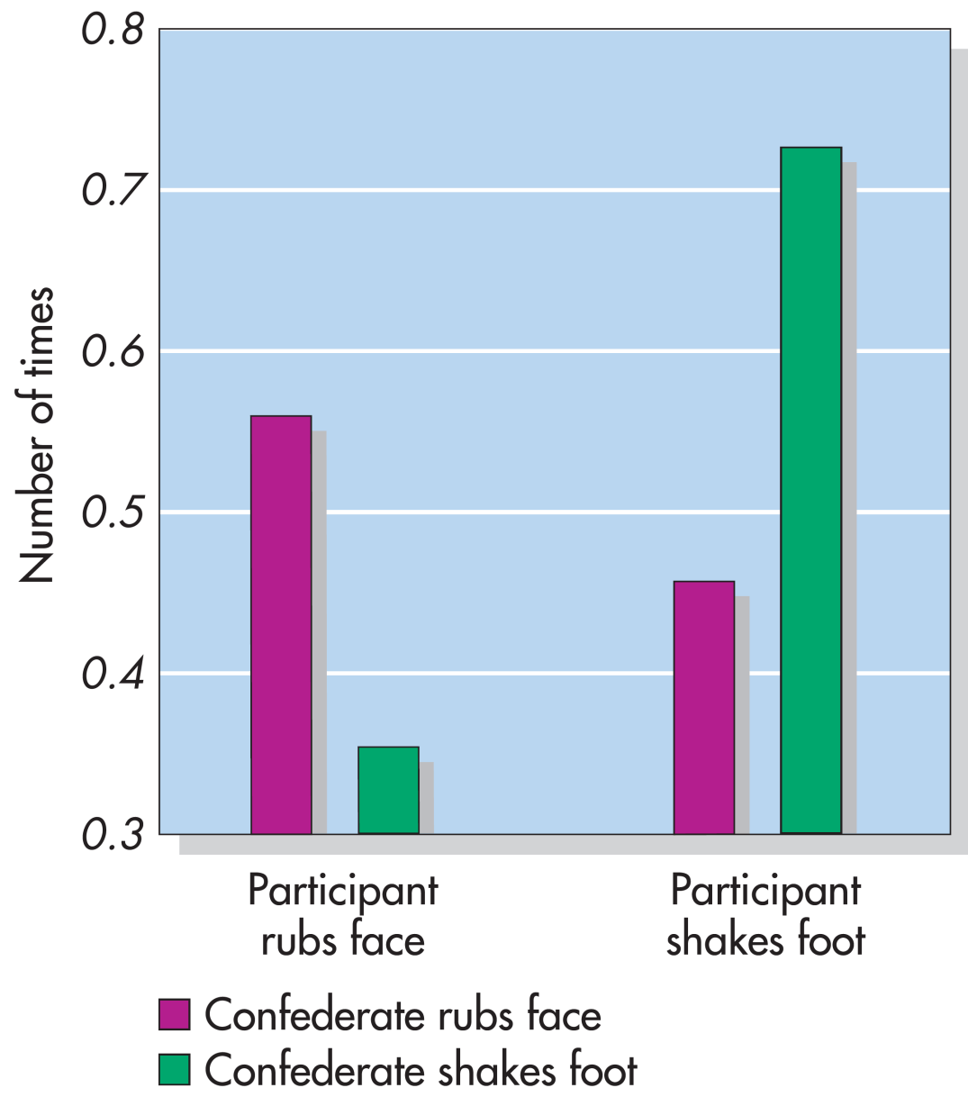
The Chameleon Effect (Chartrand & Bargh, 1999)
Notes:
Figure 7.2 The Chameleon Effect
Based on the study by Chartrand and Bargh (1999), this graph shows the number of times per minute participants rubbed their face or shook their foot when they were with a confederate who was rubbing or shaking his foot. Adapted from Kassin, S., Psychology 3rd ed. Copyright © 1997

Slide 6
Conformity
Tendency of people to change their perceptions, opinions, or behavior in ways that are consistent with social or group norms.
Would you call yourself a conformist or a nonconformist?
  When did you last breach social norms?
Researchers have found that people in North America often identify themselves as nonconformists.

Slide 7
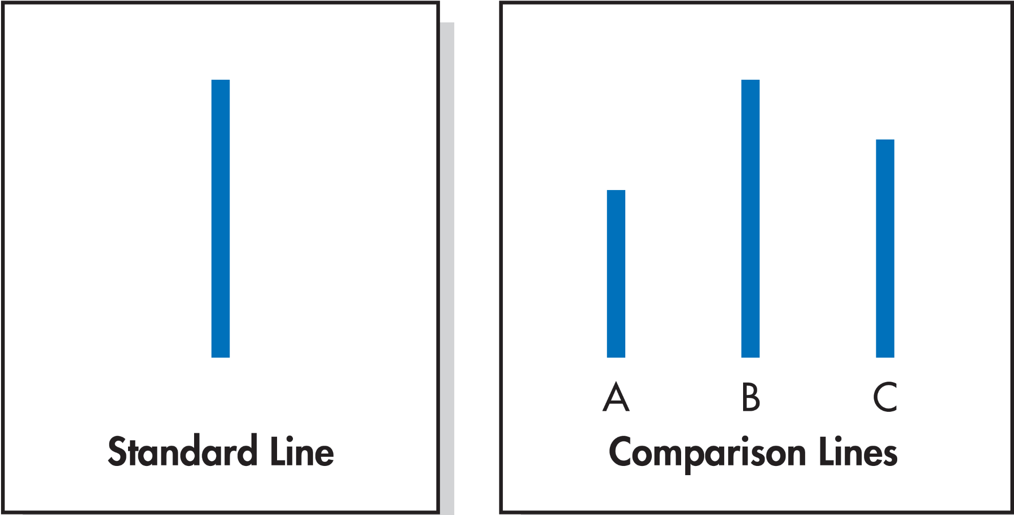
Line Judgment Task Used in Asch’s Conformity Studies
Notes:
Figure 7.4 Line Judgment Task Used in Asch’s Conformity Studies Which comparison line—A, B, or C—is the same in length as the standard line? What would you say if you found yourself in the presence of a unanimous majority that answered A or C? The participants in Asch’s experiments conformed to the majority about a third of the time. (Asch, 1955)

Slide 8
The Early Classics
Asch’s study results
  Confederates stated incorrect judgments for 12 of the 18 presentations
Subjects conformed to the incorrect majority 37% of the time
  50% went along at least half of the critical presentations.
  25% refused to agree on any incorrect group judgments.
  Remaining participants conformed on an occasional basis.

Slide 9
The Early Classics
Asch’s study – Why did people conform?
  Participants felt they were in an awkward position.
  People will sometimes conform, even when they are not convinced the group is right, to avoid feeling “conspicuous” and “crazy,” or like a “misfit.”

Slide 10
Why Do People Conform?
A desire to be right (informational influence)
  Want to make good and accurate judgments of reality and assume that when others agree on something, they must be right
Fear of ostracism (normative influence)
  Fear the consequence of rejection that follows deviance

Slide 11
Effects of Social Ostracism
Emotional distress and lower self-esteem, and feelings of loneliness, being hurt, and anger.
Evolutionary scientists point to the human need for each other in order to survive and to flourish.
Neural imaging indicates social pain of rejection produces activity in a part of the brain that is associated with physical pain.

Slide 12
Distinguishing Types of Conformity (1 of 2)
Private conformity: True acceptance or conversion
Public conformity: Compliance; a more superficial change in behavior

Slide 13
Majority Influence (1 of 2)
Factors that influence feelings of pressure and insecurity that lead to conformity:
  Group Size: Varied the size of groups, using 1, 2, 3, 4, 8, or 15 confederates
  We do more than just count the number of warm bodies—we try to assess the number of independent minds.
  A focus on norms: Social norms give rise to conformity only when we know the norms and focus on them.
      Changing people’s perceptions of norms can be used to change their behavior.

Slide 14
Majority Influence (2 of 2)
An ally in dissent:
  Asch Study: A single confederate who agreed with a participant reduced conformity by almost 80%.
  Any dissent, whether it validates an individual’s opinion or not, cannot—can break the spell cast by a unanimous majority and reduce normative pressures to conform

Slide 15
Minority Influence
People who assert their beliefs against the majority are generally seen as competent and honest, and they are also disliked and roundly rejected.
Nonconformists can act as agents of social change by using strategies for exerting minority influence.
  Minority influence: The process by which dissenters produce change within a group.

Slide 16
Processes and Outcomes of Minority Influence
How do majorities and minorities effect change?
Single process
  Accounts for both directions of social influence
Dual-process theory
  Majorities elicit public conformity by bringing stressful normative pressures on the individual.
  Minorities elicit private conformity, or conversion, by leading others to become curious and rethink their original positions.

Slide 17
Benefits of Dissent
Sparks innovation
Forces other group members to think more carefully, more openly, in new and different ways, and more creatively about a problem
Enhances the quality of a group’s output

Slide 18
Culture and Conformity
Cultures differ in the extent to which people are expected to adhere to social norms.
What determines whether a culture becomes individualistic or collectivistic?
  Complexity of a society
  Affluence of a society
  Heterogeneity

Slide 19
Compliance
Changes in behavior that are elicited by direct requests

Slide 20
Mindlessness and Compliance
People can be disarmed by the simple phrasing of a request.
We respond mindlessly to words without fully processing the information they are supposed to convey.
Disrupting mindlessness can also increase compliance.

Slide 21
The Norm of Reciprocity
The norm of reciprocity dictates that we treat others as they have treated us.
  Leads us to feel obligated to repay others for acts of kindness
  Can also be used to sanction retaliation against those who cause us harm
People may feel compelled to reciprocate, but that feeling—at least for small acts of kindness—is relatively short-lived.

Slide 22
Sequential Request Strategies
Request Shifts | Technique | Description
From small to large | Foot-in-the-door | Begin with a very small request, secure agreement, then make a separate, larger request.
 | Lowballing | Secure agreement with a request and then increase the size of that request by revealing hidden costs.
From large to small | Door-in-the-face | Begin with a very large request that will be rejected, then follow that up with a more modest request.
 | That’s-not-all | Begin with a somewhat inflated request, then immediately decrease the apparent size of that request by offering a discount or bonus.
Notes:
Table 7.3 Sequential Request Strategies Various compliance techniques are based on a sequence of two related requests. Click! The first request sets the trap. Snap! The second captures the prey. Research has shown that the four sequential request strategies summarized in this table are all effective.
credit TK

Slide 23
Obedience
Change in behavior as a result of a direct command from an authoritative figure.
May also be obtained by the symbols of authority, even without the necessary credentials
  Titles, uniforms, badges, or the trappings of success

Slide 24
Milgram’s Research: Forces of Destructive Obedience
Subject of much ethical debate
  Potential psychological harm to participants
  Profound contribution has made to our understanding of human nature and an important social problem
Experiment was presented to participants as a study on the effects of punishment on learning
  Participants exhibited an alarming degree of obedience, administering an average of 27 out of 30 possible shocks.
https://www.youtube.com/watch?v=Kzd6Ew3TraA

Slide 25
The Learner’s Protests in the Milgram Experiment (1 of 3)
  75 volts Ugh!
  90 volts Ugh!
  105 volts Ugh! (louder)
  120 volts Ugh! Hey, this really hurts!
  135 volts Ugh!!
  150 volts Ugh!!! Experimenter! That’s all. Get me out of here. I told you I had heart trouble. My heart’s starting to bother me now. Get me out of here, please. My heart’s starting to bother me. I refuse to go on. Let me out.
  165 volts Ugh! Let me out! (shouting)
  180 volts Ugh! I can’t stand the pain. Let me out of here! (shouting)
  195 volts Ugh! Let me out of here. Let me out of here. My heart’s bothering me. Let me out of here! You have no right to keep me here! Let me out! Let me out of here! Let me out! Let me out of here! My heart’s bothering me. Let me out! Let me out!
Notes:
Table 7.4 The Learner’s Protests in the Milgram Experiment As participants administered progressively more intense shocks, they heard the learner moan, groan, protest, and complain. All participants heard the same programmed set of responses. Eventually, the learner fell silent and ceased to respond. From Milgram, S., Obedience to authority: An experimental view (pp. 56–57). Copyright © 1974 by Stanley Milgram.

Slide 26
The Learner’s Protests in the Milgram Experiment (2 of 3)
  210 volts Ugh!! Experimenter! Get me out of here. I’ve had enough. I won’t be in the experiment any more.
  225 volts Ugh!
  240 volts Ugh!
  255 volts Ugh! Get me out of here.
  270 volts (Agonized scream) Let me out of here. Let me out of here. Let me out of here. Let me out. Do you hear? Let me out of here.
  285 volts (Agonized scream)
  300 volts (Agonized scream) I absolutely refuse to answer any more. Get me out of here. You can’t hold me here. Get me out. Get me out of here.
  315 volts (Intensely agonized scream) I told you I refuse to answer. I’m no longer part of this experiment.
  330 volts (Intense and prolonged agonized scream) Let me out of here. Let me out of here. My heart’s bothering me. Let me out, I tell you. (Hysterically) Let me out of here. You have no right to hold me here. Let me out! Let me out! Let me out! Let me out of here! Let me out! Let me out!
Notes:
Table 7.4 The Learner’s Protests in the Milgram Experiment (cont'd.) As participants administered progressively more intense shocks, they heard the learner moan, groan, protest, and complain. All participants heard the same programmed set of responses. Eventually, the learner fell silent and ceased to respond. From Milgram, S., Obedience to authority: An experimental view (pp. 56–57). Copyright © 1974 by Stanley Milgram.

Slide 27
The Learner’s Protests in the Milgram Experiment (3 of 3)
Experimenter’s responses to participants’ expressions of concern or reluctance to continue
  Please continue (or please go on).
  The experiment requires that you continue.
  It is absolutely essential that you continue.
  You have no other choice; you must go on.

Slide 28
Participants’ Response to the Milgram Experiment
On average, the group of participants estimated that they would call it quits at the 135-volt level.
  Psychiatrists, college students, and middle-class adults
Not a single person thought he or she would go all the way to 450 volts.
Similar estimates that other people would not deliver the maximum shock

Slide 29
Milgram’s Results Showed an Alarming Degree of Obedience
Study involved 40 men from the New Haven, Connecticut, area.
  Administered an average of 27 out of 30 possible shocks
  26 of the 40 participants—65%—delivered the ultimate punishment of 450 volts

Slide 30
The Obedient Participant
Virtually all of Milgram’s participants, including those who had administered severe shocks, were tormented by the experience
  Many pleaded to be allowed to stop but continued when the experimenter refused
  No gender difference; replication with 40 women showed the same results (65% gave the full 450 volts)

Slide 31
The Obedient Participant
Milgram’s basic findings have been obtained in several different countries and among different age groups.
Are we all Nazis? No—an individual’s character makes a difference.

Slide 32
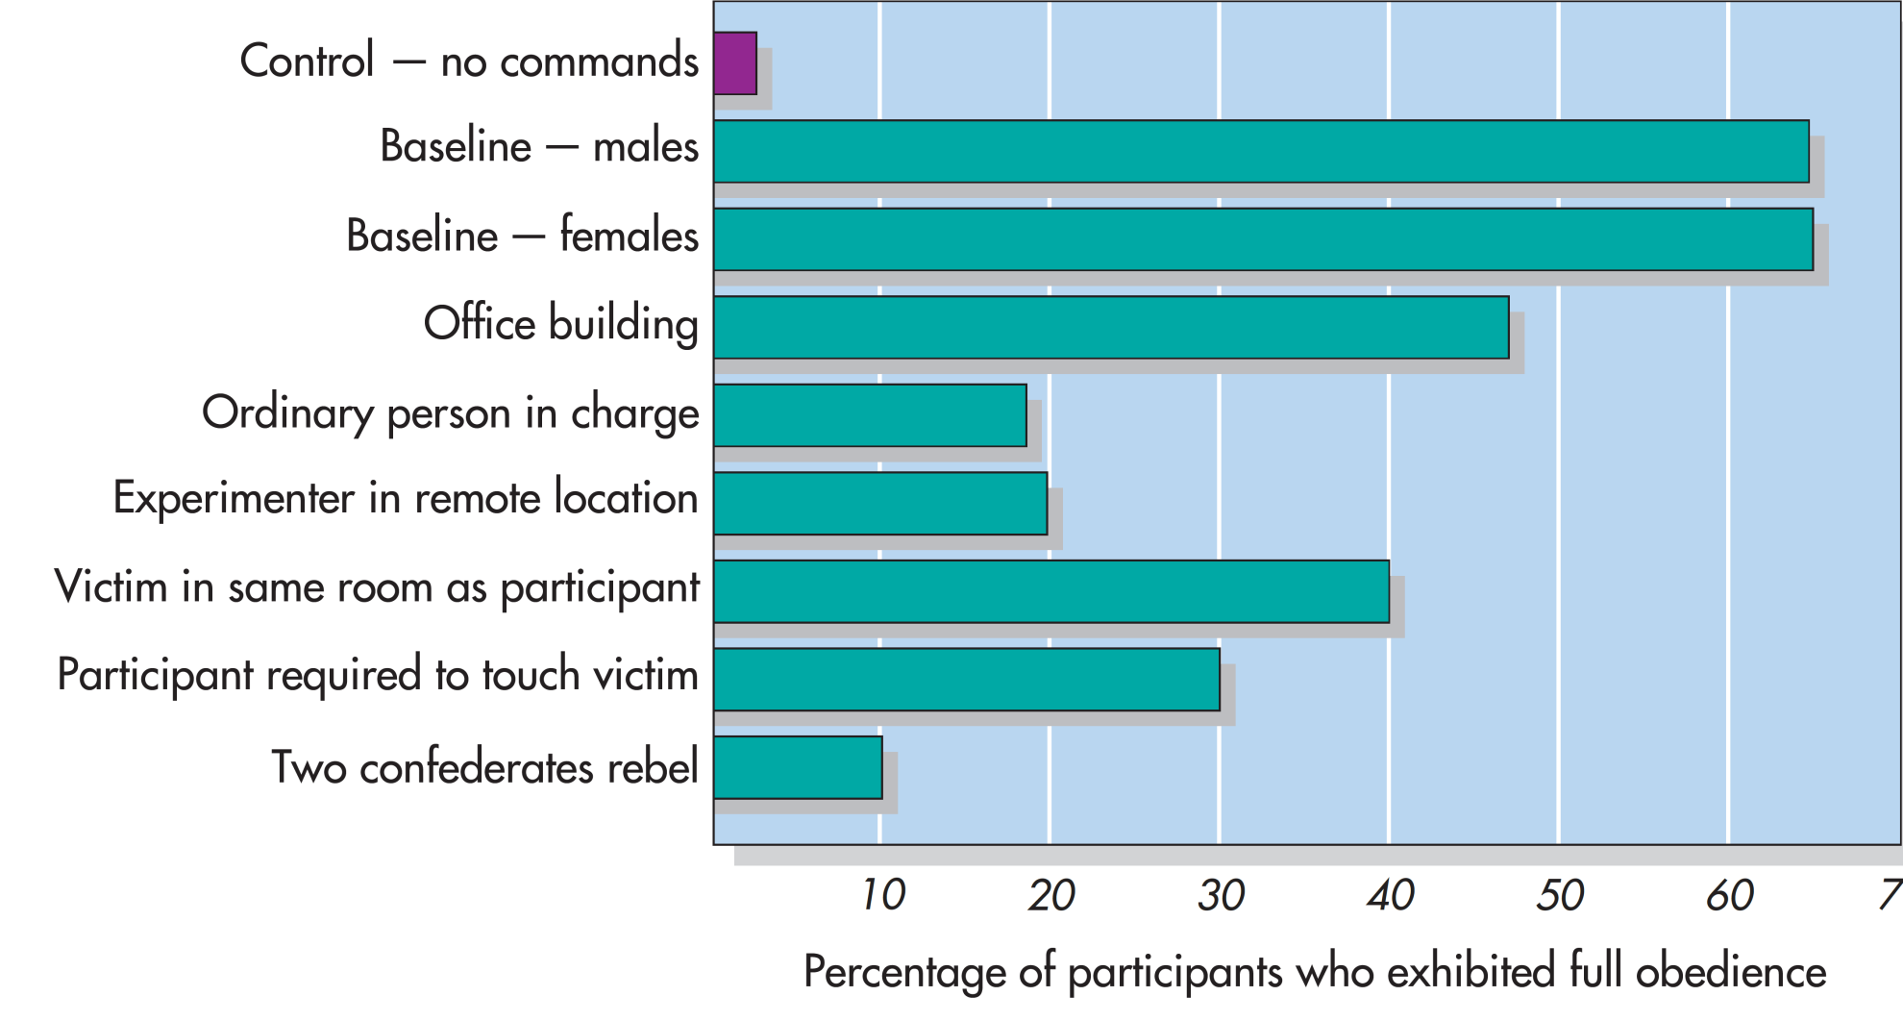
Factors That Influence Obedience
0
Notes:
Figure 7.8 Factors That Influence Obedience Milgram varied many factors in his research program. Without commands from an experimenter, fewer than 3% of the participants exhibited full obedience. Yet in the standard baseline condition, 65% of male and female participants followed the orders. To identify factors that might reduce this level, Milgram varied the location of the experiment, the status of the authority, the participant’s proximity to the victim, and the presence of confederates who rebel. The effects of these variations are illustrated here. Milgram, 1974

Slide 33
The Authority
Important factors in Milgram’s results: the authority figure
  Destructive obedience required the physical presence of a prestigious authority figure.
  Rate of total obedience dropped to 48%.
  Replacing the experimenter with an ordinary person—supposedly another participant—there was a sharp reduction to 20%.

Slide 34
The Procedure
Elements of the procedure
  Participants were led to feel relieved of personal responsibility for the victim’s welfare.
  Gradual escalation in small increments was used
  The situation was novel, with unknown norms
  The task was quickly paced, preventing participants from considering their values and options, thinking about possible consequences, or making careful decisions.

Slide 35
Lingering Questions
Why did Milgram’s participants follow orders?
What are the moral implications of their behavior?
  Do situational forces provide an excuse?
    The moral question
  Do social psychologists unwittingly excuse the perpetrators?
  Does focusing on situational forces let them off the hook of responsibility?

Slide 36
Defiance: When People Rebel
Social influence can also breed rebellion and defiance.
Synchrony of behavior can have a unifying effect on people, increasing the tendency to follow what others are doing.
The mere presence of one ally in an otherwise unanimous majority gives individuals the courage to dissent.

